Slide 1
VIDEO SEMANTIC SEARCH ENGINE
The Intelligent Video Navigator
▶
Eliminating the Manual Video Hunt with Instant Search
SEMANTIC SEARCH FOR VIDEO
Notes:
Welcome everyone, and thank you for your time. Today I am thrilled to present YashFlix AI — a modern enterprise video search platform designed to turn hours of passive, unsearchable video recordings into active, structured corporate intelligence. Over the next several minutes I will walk you through the problem, the platform, the technology that powers it, and the strategic value it delivers to our teams.

Slide 2
SESSION ROADMAP
Today's Agenda
Eight stops from the core question to strategic outlook
01
Problem Statement
02
Introduction To The Tool
07​
03
Tech Stack
04
The Ingestion Phase
05
Snowflake
06
The Query Phase
07
Applications & Future Scope
08
Live Demo
Notes:
This is the road map for our session today. We will start with a core question about how we spend our time, highlight the corporate challenges we are addressing, look at the underlying platform mechanics, step into a live demonstration, and conclude with future growth opportunities. Each section is intentionally focused on business outcomes rather than technical implementation.

Slide 3
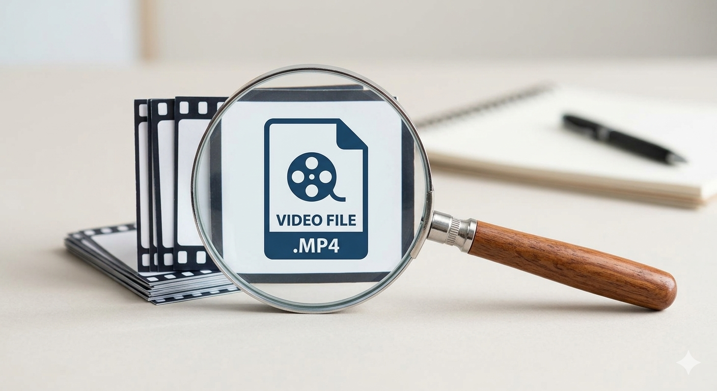
01— PROBLEM STATEMENT
Problem Statement
Develop a tool designed to accept video files as input and return the timestamps of the uploaded video described by the user via natural language text.
Context disappears over time
Memory fades quickly, turning what was a clear, aligned discussion into a blur of misremembered details and conflicting follow-ups weeks later.
Decisions evaporate at meeting close
Critical institutional decisions and action items disappear the moment a virtual meeting room closes.
Manual review does not scale
Hand reviewing recordings creates massive reporting delays and severe human review fatigue.
Notes:
Unstructured data is a massive challenge for modern businesses. When knowledge is trapped inside video files, teams often duplicate efforts simply because finding the original discussion is too labor-intensive. The industry benchmark you see on the right is widely cited — roughly eighty percent of enterprise data lives in unstructured formats, and video is the fastest-growing slice of that. YashFlix AI is specifically engineered to make that slice productive.

Slide 4
02 — INTRODUCTION TO THE TOOL
The Intelligent Video Navigator
Type the concept. Watch the exact moment.
01
Concept-based queries
what did the client say about delivery dates?
A unified, intuitive interface where teams can query concepts — not literal keyword strings.
▼
02
Semantic understanding
Automatically processes spoken dialogue and builds rich conceptual, semantic maps.
▶
03
Direct UI integration
Instantly snaps a responsive video player timeline head directly to the millisecond a topic is raised.
00:14:32 — match
Notes:
YashFlix AI acts as an internal search engine for your company's recordings. If you can remember a topic, phrase, or requirement mentioned weeks ago, you can type it in, hit search, and watch the exact clip instantly. The experience is intentionally familiar — it looks and behaves like a consumer search bar, so adoption requires no training or change management.

Slide 5

03 — TECH STACK
Retrieve Process and Store
Three pillars chosen for speed, security, and enterprise stability
WEB GATEWAY
AUDIO PARSING
DATA CLOUD
Python + FastAPI
OpenAI Whisper
Snowflake
High-speed web gateways that ensure seamless data verification and instant UI communication.
World-class engine that securely translates verbal nuances into rich, structured text assets.
Secure cloud foundation that maximizes data isolation, governance, and cloud efficiency.
Notes:
We chose this stack because it balances speed with enterprise-grade stability. FastAPI gives us a fast, predictable web layer that integrates cleanly with our existing services. OpenAI's Whisper engine handles audio with industry-leading accuracy across accents and acoustic conditions. And Snowflake provides the secure cloud foundation that lets us govern, scale, and protect all of this without sending sensitive content to public third-party services.

Slide 6
04— THE INGESTION PHASE
The Transformation Engine
From secure upload to instantly searchable asset in four steps
01
02
03
04
⬆
▶
♪
▶
✦
▶
[ ]
Secure Upload
Audio Isolation
Transcription Mapping
Contextual Encoding
Upload an internal .mp4 video file directly through the web portal.
System securely writes the file and instantly isolates the audio track.
Engines map exact timestamp coordinates for every word spoken.
Text data maps are instantly converted into deep mathematical vector embeddings.
ASSET INDEXED — READY TO SEARCH
Notes:
To guarantee absolute data consistency, our application uses a sequential pipeline. The application holds the request active until the video has been broken down, transcribed, and indexed into the database, meaning when the interface turns green, the file is immediately ready for company-wide search. There is no ambiguity, no silent failure mode, and no need for the user to refresh and hope.

Slide 7
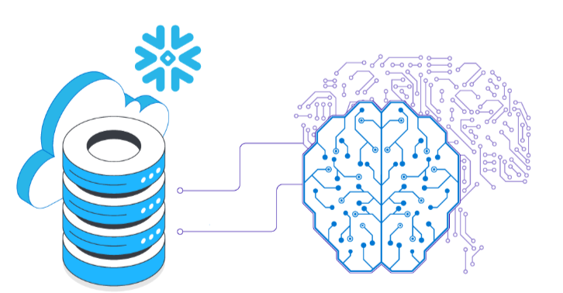
05 — SNOWFLAKE
The Snowflake Advantage
Snowflake is a cloud-based data platform that stores, organizes, and analyzes huge amounts of data.
Native Vector Storage
Snowflake has a built-in, dedicated data type specifically designed to hold AI vector embeddings
Cortex AI Capabilities
Granular sentence-level transcription mapping phrase to exact video timecodes.
Similarity Calculations
Snowflake calculates how closely a user's search query matches the video timeline mathematically using built-in functions like Cosine Similarity, directly via standard queries.
Notes:
Snowflake is the core brain of this project. By utilizing Snowflake Cortex AI, we can run advanced semantic logic without sending our private company data to public third-party applications, giving management absolute security peace of mind. The same governance, encryption, and access controls that protect our financial data now protect every transcript and every search.

Slide 8
06 — THE QUERY PHASE
The Semantic Retrieval Flow
01
04
02​
03
STEP 1 — QUERY INPUT
STEP 2 — VECTOR CONVERSION
STEP 3 — SIMILARITY MATCHING
STEP 4 — PLAYBACK
User Intent Capture
Vector Embedding
Vector Math Analysis
Timeline Cursor Alignment
The user enters a natural language scenario description or conversational topic directly into the portal's search bar.
The local embedding model processes the text input in real time, instantly translating the query into a high-dimensional vector.
The engine executes ultra-fast vector cosine similarity calculations against the stored video transcript indexes inside the database.
The engine then returns those precise coordinates back to the UI, allowing the media player to instantly snap its play head right to the exact second the discussed scenario occurred

Slide 9
07 — APPLICATIONS
Potential Applications
High-stakes industries where this solution turns raw video into precision intelligence
▶
📖
🛡
01 — CREATIVE INDUSTRIES
02 — ENTERPRISE
03 — MISSION CRITICAL
Media & Entertainment
Knowledge & Compliance
Security & Operations
Cinematic Scene Retrieval
Enterprise Onboarding
Security Video Intelligence
Describe a scene in natural language and jump to the exact frame.
Turn bootcamps and code walkthroughs into searchable learning modules.
Locate anomalies in hours of surveillance footage with natural language.
End the “Dailies” Bottleneck
QA & Customer Success
Critical Communications
Skip raw b-roll and surface creative concepts or emotional beats in seconds.
Index client calls and screen-shares to verify agreements and audit performance.
Search radio, dispatch, and command-center channels for spoken alerts.
Notes:
This platform isn't restricted to standard corporate meetings; its application extends across multiple high-stakes industries by transforming how we interact with raw media. In security and operations, it bridges text queries with raw surveillance or radio recordings, turning hours of blind monitoring into precision auditing. In the enterprise space, it acts as the ultimate knowledge repository—allowing cross-functional teams to instantly mine insights from technical hand-offs and client calls, cutting down on time-wasting scavenger hunts. Finally, for anyone who loves cinema or works in post-production, finding the perfect shot in hundreds of hours of raw footage is notoriously painful. With YashFlix AI, we are bringing a ‘Director’s Cut’ mentality to video search. A filmmaker can literally type a creative description of a scene—focusing on a specific emotion, dialog, or a visual backdrop—and the system maps that description directly to the exact millisecond inside the video timeline. We are removing the tedious mechanical search so creators can focus entirely on the art of storytelling.

Slide 10
07 — FUTURE SCOPE
Future Scope
Two high-impact enhancements to deepen infrastructure and maximize user value
☁
01 — NATIVE CLOUD INGESTION
✨
02 — AI SUMMARIZATION LAYER
Upgraded Snowflake Infrastructure
Generative Media Intelligence
Native AI Audio Transcription
Automated Video Summarization
Migrate transcription directly into the data cloud using Snowflake’s native Cortex AI_TRANSCRIBE.
Generate instant text overviews and key takeaways from long recordings via Cortex LLM processing.
Perimeter Security
Intelligent Navigation
Eliminates external extraction servers, executing the entire media lifecycle inside a secure, singular data vault.
Insert automated chapter markers and verbal action-item tracking beside the responsive player layout.
Notes:
As we look past our current operational prototype, our strategic roadmap focuses on two high-impact enhancements designed to deepen our infrastructure and maximize user value. First, we are upgrading our core infrastructure by migrating our transcription phase directly into the data cloud using Snowflake's native Cortex AI_TRANSCRIBE capabilities. By processing audio native to Snowflake, we achieve absolute data isolation—meaning sensitive internal recordings never have to touch an external processing server. Second, we are moving from simple timestamp tracking into true generative intelligence. We will be adding an automated summarization layer directly into the dashboard interface. Instead of just finding a specific timestamp, a user will be presented with instant, high-level structural breakdowns, automated chapter markers, and an interactive list of verbal action-items right next to the video player timeline. This takes us from a search utility to an end-to-end knowledge asset management system.

Slide 11
08— LIVE DEMO
Let's see the utility in action
From spoken concept to exact playback — live
yashflix.ai / search
"Show me where the architecture review approved the new caching layer"
▶
Notes:
Let's step away from the slides and look at how this operates in practice. I will demonstrate uploading an internal video, searching for a specific business concept, and showing how the player eliminates manual searching. Pay attention to how quickly results appear and how precisely the playhead snaps to the exact moment a topic was discussed.

